Slide 1
A Simple Post-Quantum Non-Interactive Zero-Knowledge Proof from Garbled Circuits
Hongrui Cui, Kaiyi Zhang
INSCRYPT 2021
Notes:
Good morning everyone, I am Rick. Today I am going to share with you “a simple post-quantum non-interactive zero-knowledge proof from garbled circuits”. This is a joint work with my colleague Kaiyi Zhang.

Slide 2
Synopsis
Introduction
Preliminaries
Construction
Notes:
Let’s begin with some overview and motivations of this work.

Slide 3
Zero-Knowledge Proofs
Allows a prover to convince any NP statement to a verifier without leaking the certificate
First proposed by Shafi Goldwasser, Silvio Micali, and Charles Rackoff in 1985
Applications: e-voting, blockchain privacy, digital signature, …
Notes:
Zero-knowledge proof is a central object in modern cryptography. It was first proposed by Goldwasser, Micali, and Reckoff in 1985 and after almost four decades of development, it can achieve efficiency that can be accepted by real-world applications and still of both theoretical and practical interests.

Slide 4
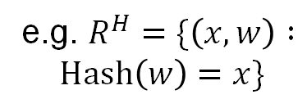
Zero-Knowledge Proofs
Learning curve is a bit steep
Take the 3COL-protocol as a starting point
Cumbersome to understand and implement as a whole
$$NP Relation \text{⟹} 3SAT \text{⟹} 3COL \text{⟹} ZKP$$
e.g. $R^{H}=\{\left(x,w\right) :$
$$Hash\left(w\right)=x\}$$
Cook-Levin
Reduction
Another
Reduction
Interactive
ZKP w/ Com.
Notes:
Despite the advantages, we find that it still takes some effort to completely understand a zero-knowledge proof protocol. And we mean not only the current, state-of-the-art protocols but also the somewhat primitive ones like the three-coloring protocol which commits to node coloring and opens a challenged edge. Suppose we want to prove a relation of hash preimage. What we have to do is to first construct a 3SAT statement that corresponds to the hash circuit, then transform it to a three-coloring instance by another reduction, and finally apply the three-coloring protocol to get a zero-knowledge proof protocol. Although the process is not difficult per-se, it can be cumbersome to put them together especially when considering implementations.

Slide 5
Our Work
We identify the learning curve of ZKP
A simple ZKP protocol based only on a garbling scheme (folklore countermeasure against quantum adversary)
Easy to understand and implement (728 loc)
Notes:
In this work, we identify the above problem and propose a very simple zero-knowledge proof that is great for pedagogical or teaching purposes. Our protocol relies only on symmetric-key primitives and can be boosted to be post-quantum by doubling the key length. Additionally, to demonstrate its simplicity, we implemented the protocol using only 728 lines of C++ with dependency on OpenSSL only.

Slide 6
Synopsis
Introduction
Preliminaries
Construction
Notes:
Next we review the building blocks of our construction.

Slide 7
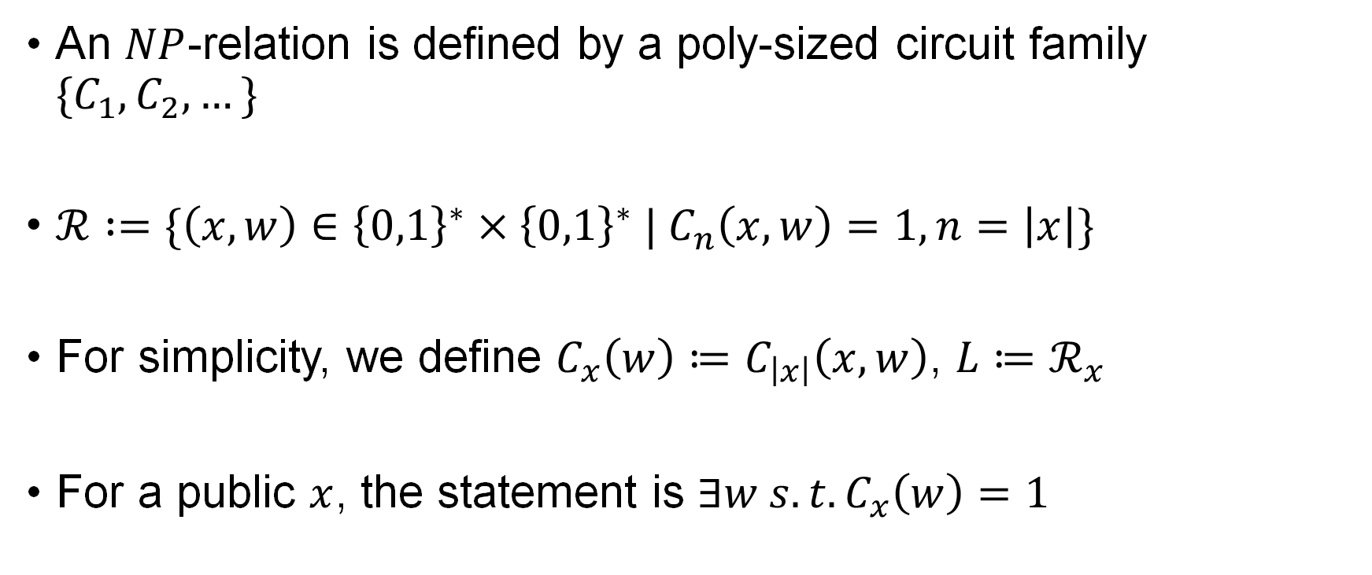
NP-Relation
An $NP$-relation is defined by a poly-sized circuit family $\{C_{1},C_{2},…\}$
$ℛ :=\{\left(x,w\right)∈{\left\{0,1\right\}}^{∗}×{\left\{0,1\right\}}^{∗} | C_{n}\left(x,w\right)=1,n=\left|x\right|\}$
For simplicity, we define $C_{x}\left(w\right)≔C_{\left|x\right|}\left(x,w\right)$, $L≔ℛ_{x}$
For a public $x$, the statement is $∃w s.t. C_{x}\left(w\right)=1$
Notes:
First of all let’s fix some notation on NP-relations. An NP-relation is a set of two-tuples of binary strings, defined by a family of Boolean circuits. The circuits are indexed by the instance size. The first input to the circuit is the public instance x while the second one is a private witness or certificate. We denote C_x(w) to be the circuit with the first input part hard-wired and denote L as the x-part of the relation. For a public instance x, the prover needs to prove to the verifier the existence of a valid w.

Slide 8



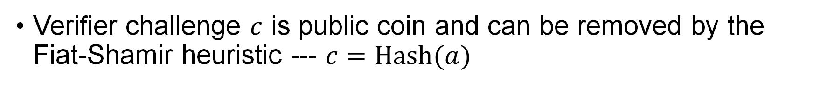
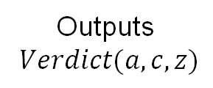
Zero-Knowledge Proof
We consider $Σ$-protocols in this work
Msg1: $a$
Msg2: $c$
Msg3: $z$
Prover
Verifier
Outputs
$Verdict(a,c,z)$
Verifier challenge $c$ is public coin and can be removed by the Fiat-Shamir heuristic --- $c=Hash(a)$
Notes:
In this work we focus on sigma-protocols. A sigma-protocol is a three-round protocol where the second message is a public-coin challenge. It is folklore to remove the interaction by applying the Fiat-Shamir heuristic, that is, to set the challenge as the hash of the first message. In this way, the prover can only send a single message to the verifier in order to convince her of the statement.

Slide 9
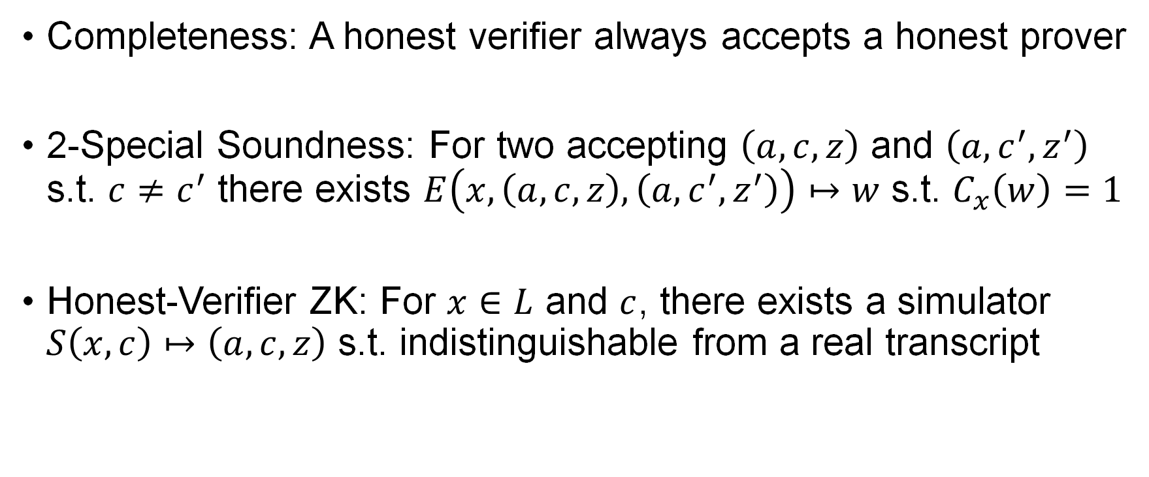
Zero-Knowledge Proof
Completeness: A honest verifier always accepts a honest prover
2-Special Soundness: For two accepting $\left(a,c,z\right)$ and $\left(a,c^{′},z^{′}\right)$ s.t. $c≠c^{′}$ there exists $E\left(x,\left(a,c,z\right),\left(a,c^{′},z^{′}\right)\right)↦w$ s.t. $C_{x}\left(w\right)=1$
Honest-Verifier ZK: For $x∈L$ and $c$, there exists a simulator $S\left(x,c\right)↦\left(a,c,z\right)$ s.t. indistinguishable from a real transcript
Notes:
A zero-knowledge proof system needs to satisfy the following three properties. The first one is completeness, meaning that an honest verifier will always accept an honest prover on valid inputs. The second property is 2-special soundness, meaning that there exists an efficient extraction procedure to extract a witness from two accepting transcripts that shares the first message but differs in the random challenge. The third property is honest-verifier zero-knowledge, meaning that for any x inside L, there exists an efficient simulation procedure to generate a transcript that is indistinguishable from the one from a real execution.

Slide 10
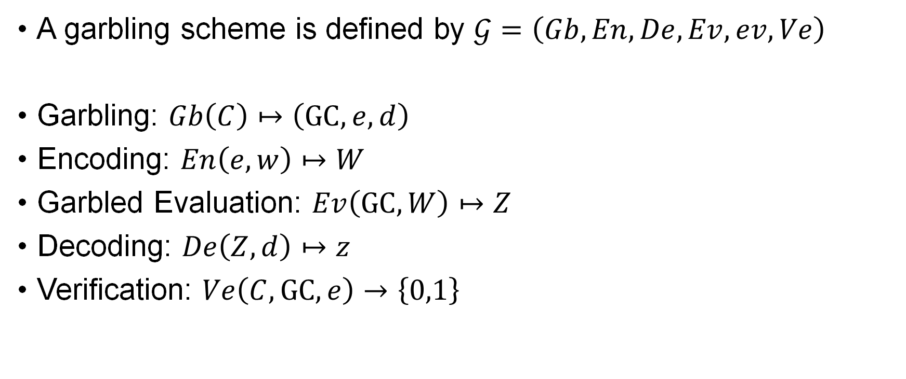
Garbling Scheme [BHR12]
A garbling scheme is defined by $𝒢=\left(Gb,En,De,Ev,ev,Ve\right)$
Garbling: $Gb\left(C\right)↦\left(GC,e,d\right)$
Encoding: $En\left(e,w\right)↦W$
Garbled Evaluation: $Ev\left(GC,W\right)↦Z$
Decoding: $De\left(Z,d\right)↦z$
Verification: $Ve\left(C,GC,e\right)→\left\{0,1\right\}$
Notes:
In this work we build our ZKP on a garbling scheme. We follow the works of Bellare for the formalization of garbling. A garbling scheme consists of six algorithms. The garbling algorithm takes a plaintext circuit C and generates a garbled circuit GC, the encoding information e, and the decoding information d. The encoding procedure takes the e and the plaintext input w and outputs the encoded input W. The garbled evaluation algorithm takes garbled circuit and input and outputs a garbled output, which with the decoding information can be recovered to plaintext output by a decoding function. Finally, we require a verification algorithm that takes plaintext circuit C, garbled circuit GC, and encoding information e to generate a verdict whether the circuit was garbled correctly.

Slide 11
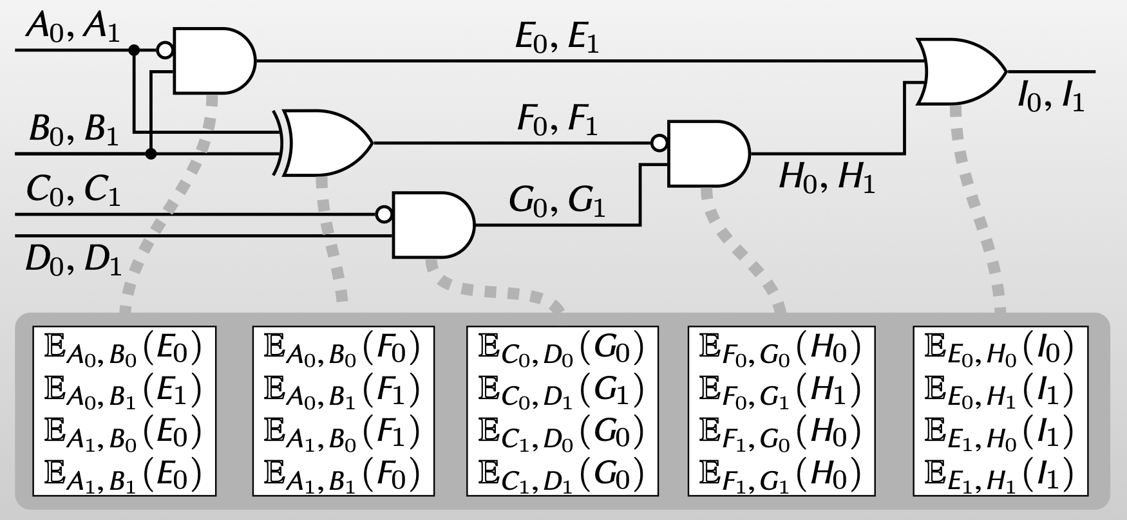
Garbling Scheme [Yao86]
Slide from the 2PC course of Mike Rosulek
Notes:
Here we recall the fundamental garbling scheme of Andrew Yao. This slide is taken from Mike Rosulek’s 2PC course so courtesy of him. The garbling procedure starts by assigning two labels for each wire of the circuit, one for true and one for false. The garbled circuit is a set of garbled truth tables, one for each gates in the circuit, where each row is the encryption of the output label by the concatenation of two corresponding input labels. The encoding algorithm simply returns the labels that corresponds to input values. The evaluation function decrypts the encrypted truth tables gate-by-gate and finally returns the output label. The decoding information identifies the mapping between output label and wire values.

Slide 12
Synopsis
Introduction
Preliminaries
Construction
Notes:
Finally we explain our construction and prove its security.

Slide 13
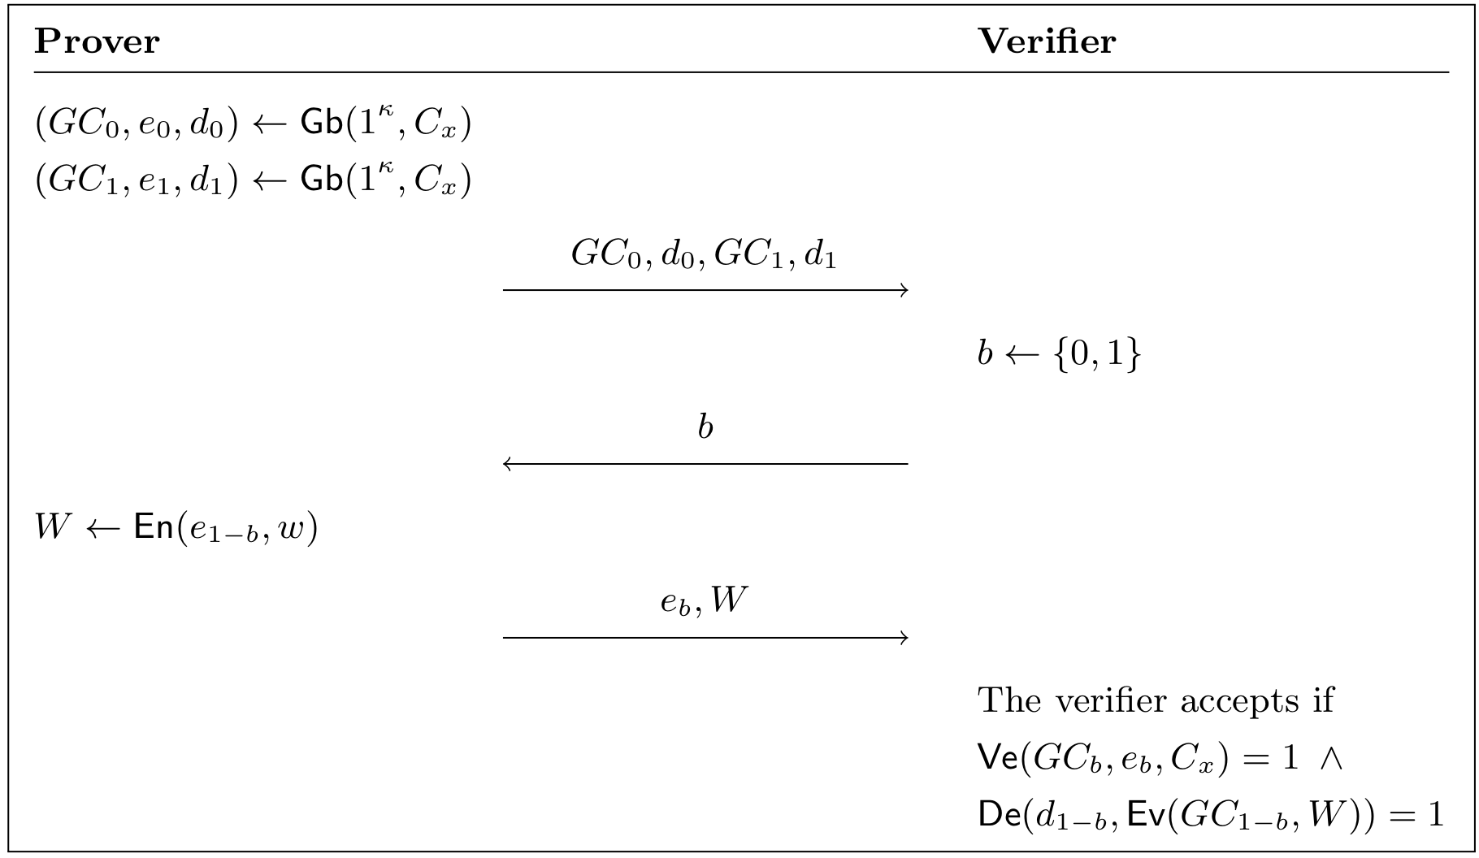
Our Sigma Protocol
Notes:
This is our zero-knowledge protocol and as we can see it is very simple. The prover starts by garbling the circuit C_x using independent random coins and sends to the verifier two garbled circuits and decoding information. Then the verifier samples a coin b and sends it to the prover. The prover’s third message is the encoding information of index b and the garbled input of index 1-b. The verifier accepts if the GC_b is garbled correctly and GC_1-b evaluates to 1.

Slide 14
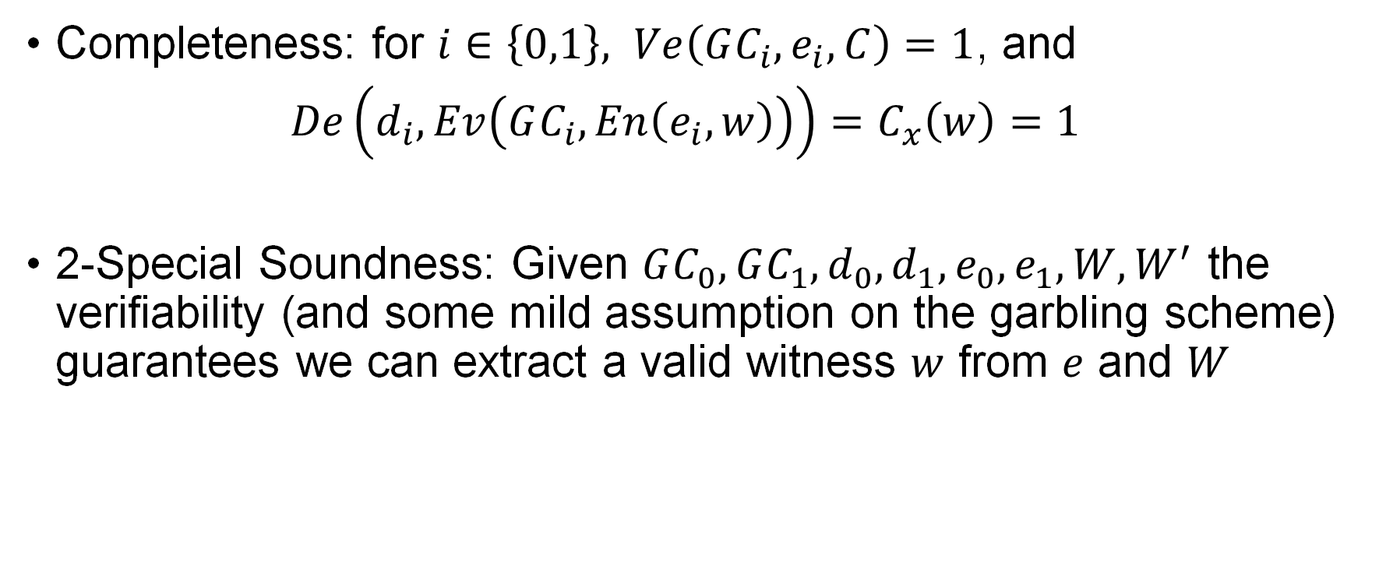
Security
Completeness: for $i∈\left\{0,1\right\}, Ve\left(GC_{i},e_{i},C\right)=1$, and
$De\left(d_{i},Ev\left(GC_{i},En\left(e_{i},w\right)\right)\right)=C_{x}\left(w\right)=1$
2-Special Soundness: Given $GC_{0},GC_{1},d_{0},d_{1},e_{0},e_{1},W,W^{′}$ the verifiability (and some mild assumption on the garbling scheme) guarantees we can extract a valid witness $w$ from $e$ and $W$
Notes:
The completeness of our scheme is straightforward since an honest prover would perform garbling faithfully and the circuit always evaluates to 1 on accepting inputs. The 2-special soundness extractor can be constructed from matching encoding information and encoded inputs and essentially the verifiability of the garbling scheme guarantees the effectiveness of the extraction.

Slide 15
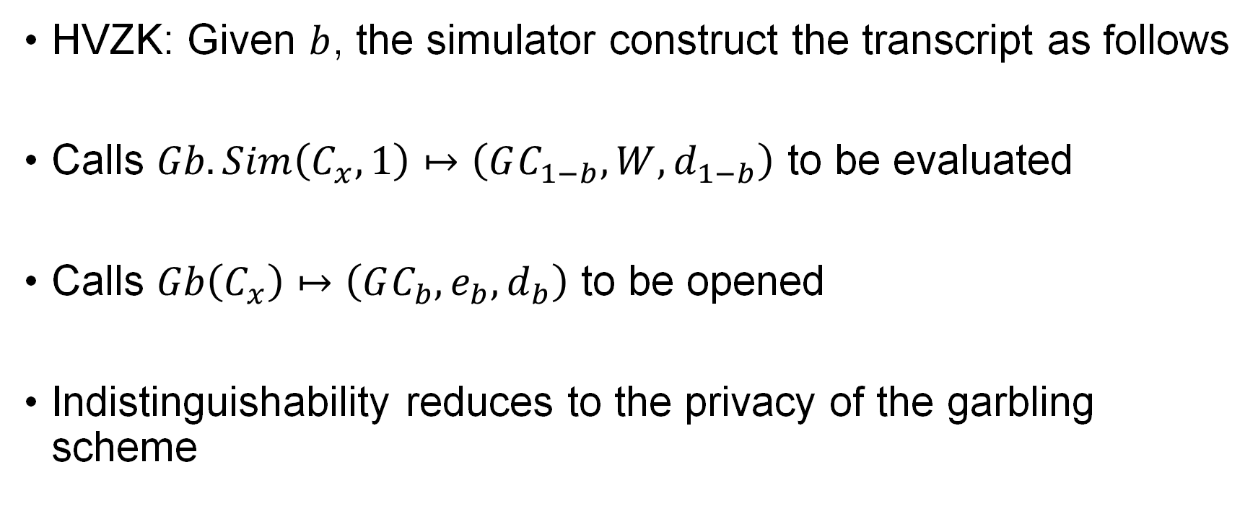
Security
HVZK: Given $b$, the simulator construct the transcript as follows
Calls $Gb.Sim\left(C_{x},1\right)↦\left(GC_{1−b},W,d_{1−b}\right)$ to be evaluated
Calls $Gb\left(C_{x}\right)↦\left(GC_{b},e_{b},d_{b}\right)$ to be opened
Indistinguishability reduces to the privacy of the garbling scheme
Notes:
Honest verifier zero-knowledge can be argued by presenting the simulator as follows: for the index 1-b we call the simulator of the garbling scheme to generate a set of transcript to be evaluated while for index b we perform garbling faithfully to generate the transcript to be opened. Altogether, the indistinguishability here reduces to that of the garbling scheme simulator, which is guaranteed by the privacy property of the garbling scheme.

Slide 16
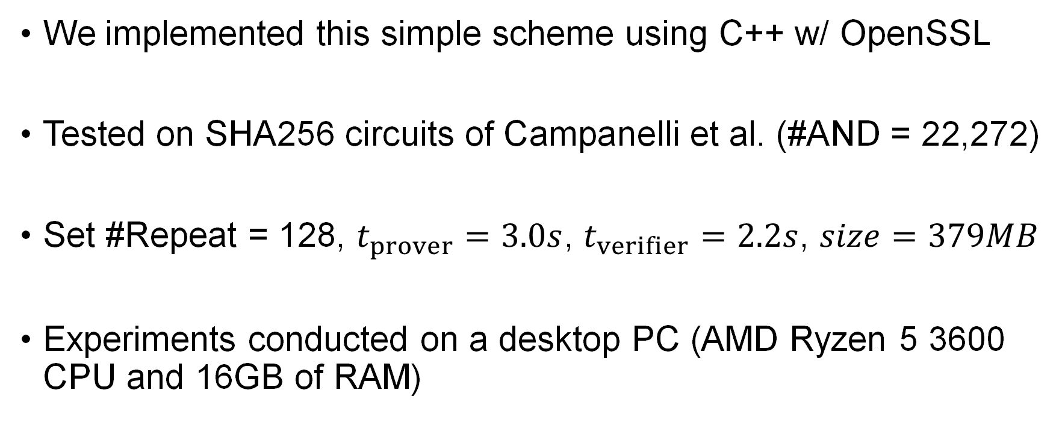
Experiment
We implemented this simple scheme using C++ w/ OpenSSL
Tested on SHA256 circuits of Campanelli et al. (#AND = 22,272)
Set #Repeat = 128, $t_{prover}=3.0s$, $t_{verifier}=2.2s$, $size=379MB$
Experiments conducted on a desktop PC (AMD Ryzen 5 3600 CPU and 16GB of RAM)
Campanelli, M., Gennaro, R., Goldfeder, S., Nizzardo, L.: Zero-knowledge contingent payments revisited: Attacks and payments for services (CCS 2017)
Notes:
Finally we conducted experiment on the proof-of-concept implementations in C++. We tested the protocol on the SHA2 circuit with 22,272 AND gates and sets the repetition count to be 128. The proving time is 3 seconds and verification time 2.2 seconds. The proof size is 379MB.

Slide 17
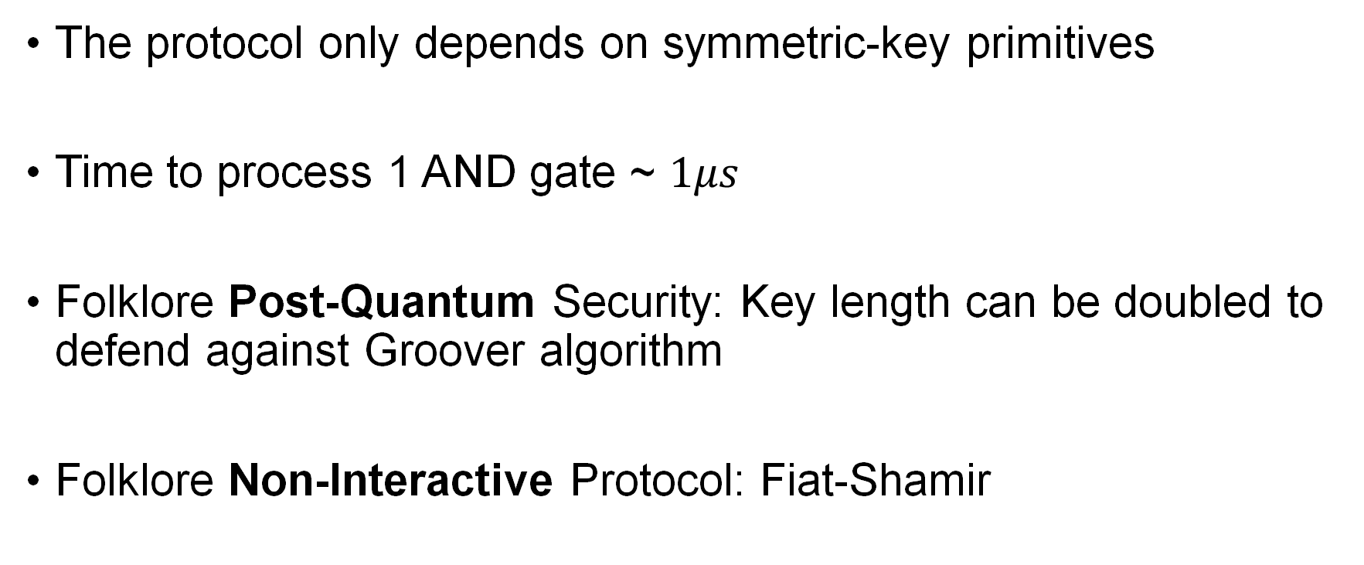
Discussion
The protocol only depends on symmetric-key primitives
Time to process 1 AND gate ~ $1μs$
Folklore Post-Quantum Security: Key length can be doubled to defend against Groover algorithm
Folklore Non-Interactive Protocol: Fiat-Shamir
Notes:
As we can see the proof size of our protocol is nowhere near the state-of-the-art. Since we only require a garbling scheme, the time complexity is not so terrible. But as we argued, the contribution of this protocol is its very simplicity. Finally, to complete the claims in the title, we can double the key length to defend against Groover’s algorithm and provide purported post-quantum security and apply the Fiat-Shamir heuristic to provide a non-interactive protocol.

Slide 18
Thank You

